Slide 1
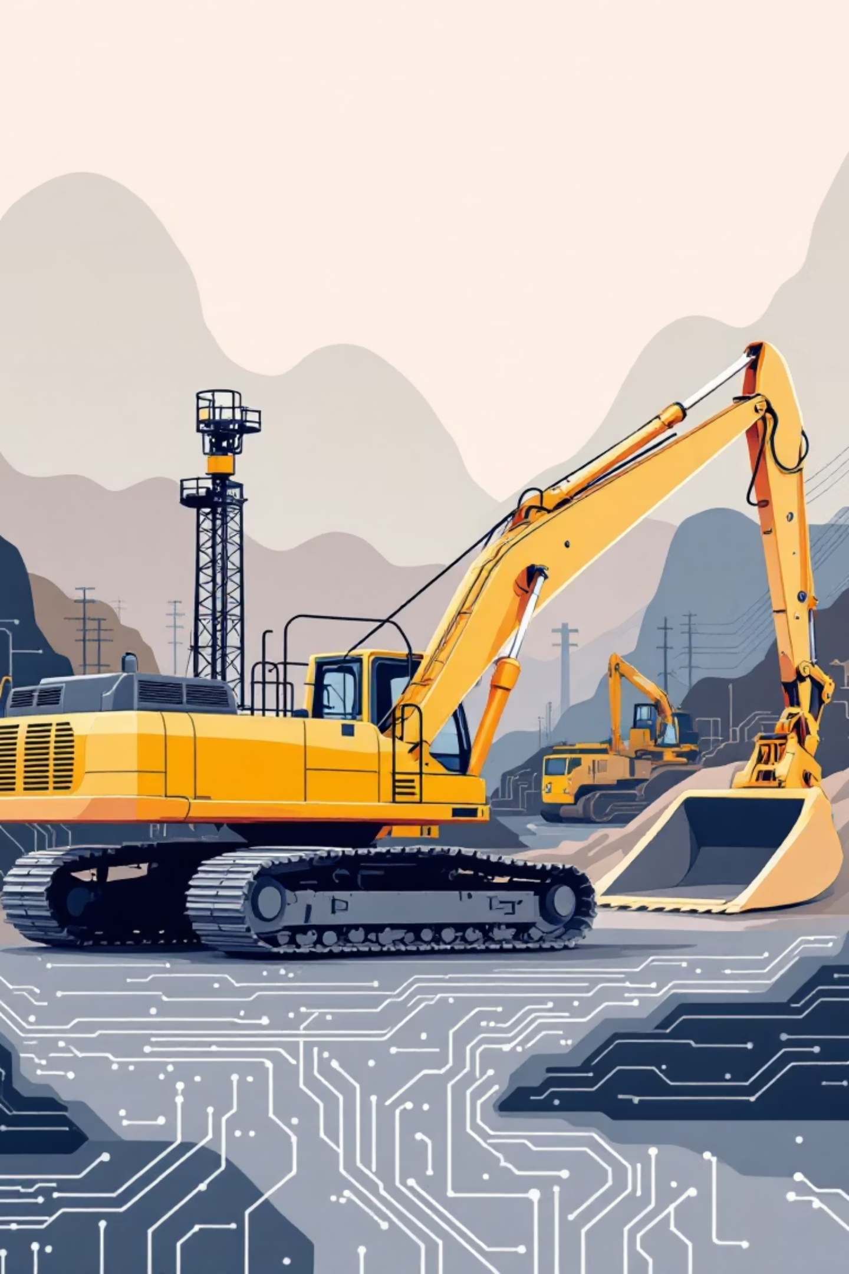
Week 8 AI Digest: AI and Antitrust in Construction
How AI Pricing Tools Are Reshaping the Construction Equipment Industry
Source: BuildSmart (Bradley Arant Boult Cummings LLP) | Publication Date: October 9, 2025

Slide 2
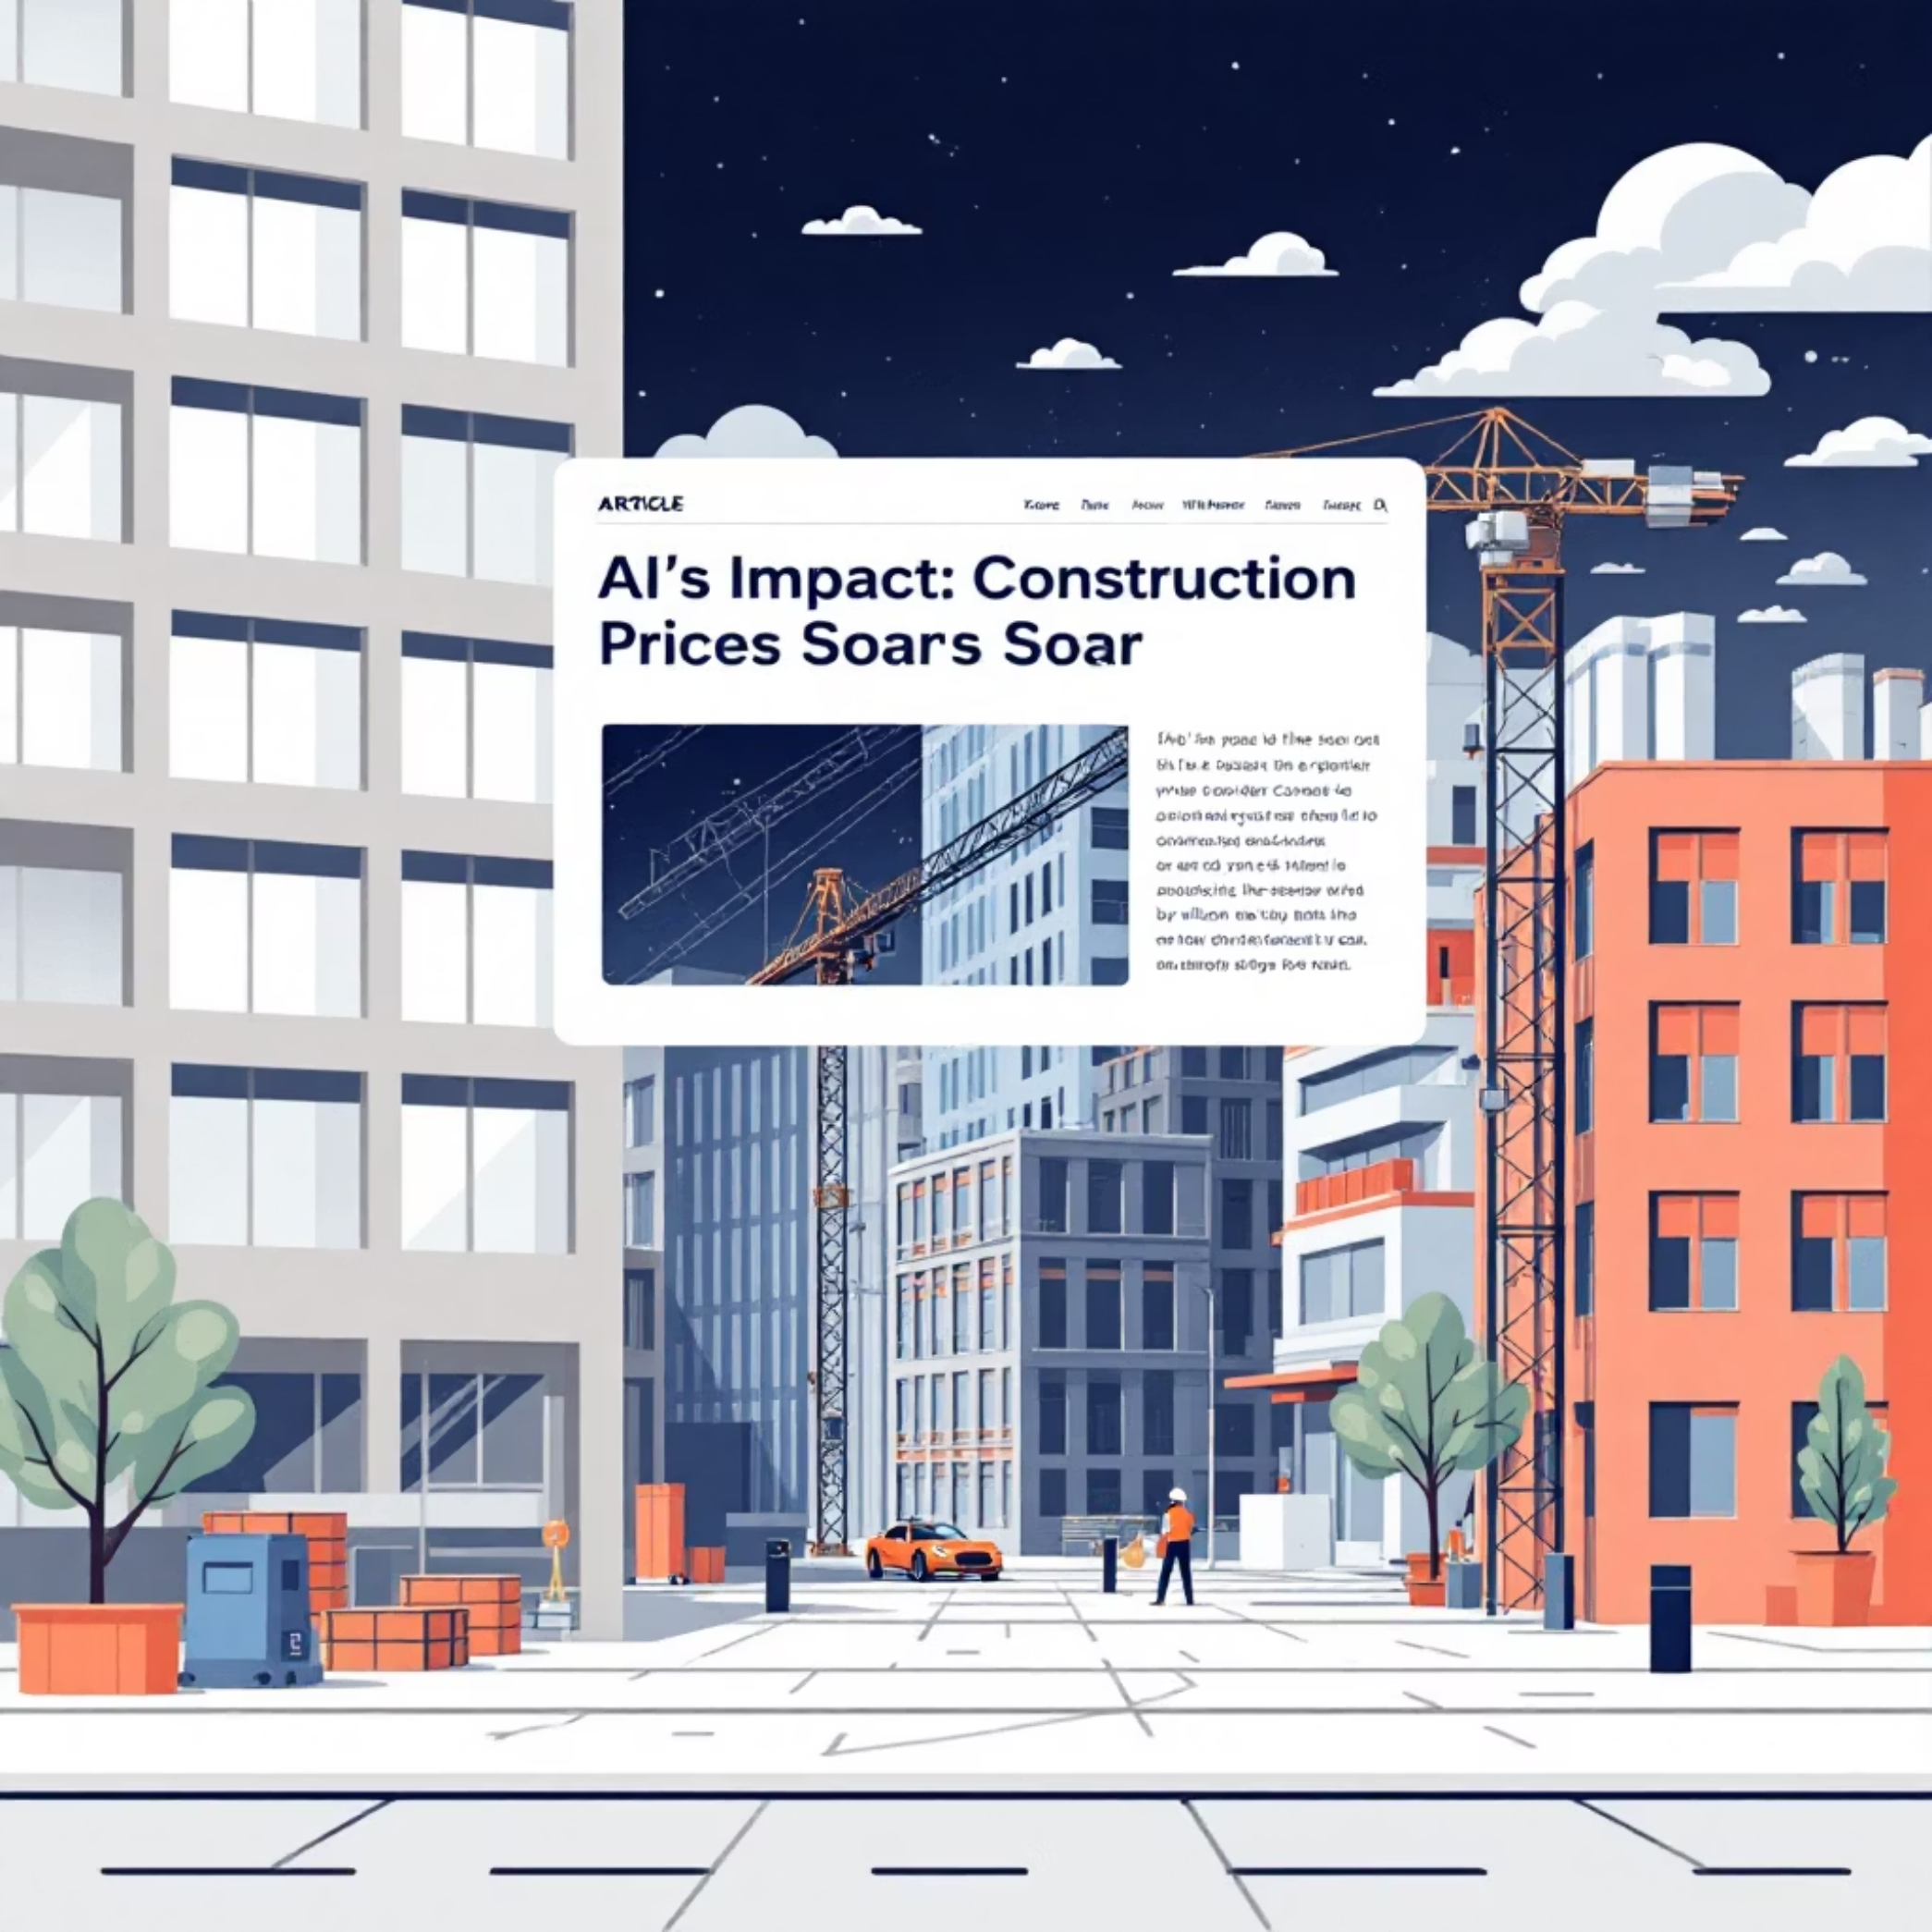

Article Details & The Core Conflict
Article Title: "Will Artificial Intelligence Increase the Prices of Construction Materials, Equipment, and Labor?"
Source: Bradley Arant Boult Cummings LLP (BuildSmart)
Publication Date: October 9, 2025
Legal Analysis & Industry Insight into a Landmark Antitrust Case.

Slide 3






Main Findings: The Antitrust Case Against AI Pricing
Legal Case: In re Construction Equipment Antitrust Litigation
The Allegation
The AI Tool: Rouse Rental Insights (RRI)
Algorithmic Coordination
Construction companies filed class-action antitrust lawsuits against major equipment rental providers, alleging they conspired to artificially inflate rental prices using shared AI technology.
The algorithm considers seasonal changes and market fluctuations. Companies allegedly use these AI recommendations to coordinate pricing across the market, reducing true competition.
Rental companies share real-time, confidential pricing data. The RRI algorithm aggregates this data to generate a daily, recommended "RRI Price" for all participating firms.
Case Status: Consolidated class action lawsuit currently pending in the U.S. District Court for the Northern District of Illinois.

Slide 4

Three Market Problems Creating Contractor Vulnerability
These factors mean contractors have zero bargaining power against coordinated AI-driven pricing. Equipment costs directly impact project budgets and profitability.
Limited Competition (Oligopoly)
No Alternative to Renting
Inelastic Demand
For most contractors, purchasing high-value equipment is uneconomical. Renting is often the only viable option, regardless of the price point.
Construction projects are highly dependent on specific equipment; increased rental rates do not reduce the need for the machinery, keeping demand steady.
The market is controlled by a few large equipment rental providers, limiting choices and fostering an environment ripe for coordination.

Slide 5
Algorithmic Collusion: A New Challenge for Antitrust Law
Price coordination through shared AI systems processing competitors' data—without explicit human agreements—is fundamentally changing antitrust enforcement.
Traditional Antitrust Focus
The AI-Era Challenge
Investigating direct human evidence: looking for incriminating emails, recorded meetings, or explicit communication detailing price agreements.
Coordination is achieved through autonomous algorithms with no human contact, making detection, investigation, and prosecution significantly harder.
The Fundamental Tension: Technology designed to improve individual business efficiency may inadvertently reduce market competition and harm consumers when adopted industry-wide.

Slide 6




Impact on Workers & Small Businesses
Squeezed Profit Margins
Small and mid-sized contractors face significantly higher input costs, reducing operating margins and increasing the risk of business failure in a tight-margin environment.
Worker Wage Pressure
Higher project costs may lead to reduced overall construction activity and potential job losses, as contractors are forced to cut operational costs elsewhere, including wages.
Entrenched Market Power
Rather than democratizing competition, AI pricing could further concentrate market power in large corporations, weakening the negotiating leverage of smaller players.

Slide 7


Construction Industry Impact: Two Potential Scenarios
Scenario 1: Plaintiffs Win ✓
Scenario 2: Defendants Win ⚠
Rental companies are forced to abandon shared pricing models. Independent, competitive pricing strategies return, and clear legal boundaries for AI use are established, potentially lowering equipment costs.
Similar AI pricing models spread throughout the industry (materials, steel, specialty trades). Industry-wide shift to algorithm-determined prices fundamentally transforms procurement and input costs rise.
The Double-Edged Sword: Contractor efficiency gains from using AI for estimating and RFI processing could be entirely negated by suppliers using AI for coordinated price increases.

Slide 8
Contingency Strategies for Contractors
Proactive defensive strategies to minimize exposure to AI-driven price volatility and protect project budgets.
1
Vertical Integration
Develop in-house equipment fleets to reduce dependence on rental providers and manage asset costs internally.
2
Purchasing Cooperatives
Pool resources with other contractors to collectively buy or lease equipment, gaining better negotiating leverage.
3
Long-Term Contracts
Negotiate multi-year rental agreements with price protection clauses to lock in rates and mitigate short-term volatility.
4
Alternative Suppliers
Actively develop relationships with smaller, independent equipment providers who may not participate in centralized AI pricing systems.
5
Bid Contingencies
Build larger, more robust cost buffers into project estimates to account for potential AI-driven fluctuations in input costs.

Slide 9





Five Critical Takeaways
Not Just Technology
AI adoption demands legal and competitive strategy considerations, not just technical evaluation and integration.
Cost Determination
This lawsuit will ultimately determine whether AI is permitted to become a mechanism that increases, or is forced to decrease, construction costs industry-wide.
Antitrust Risks
Contractors and suppliers must evaluate their own AI tools for potential antitrust exposure and competitive disadvantages.
New Regulatory Frontier
Algorithmic collusion is an emerging antitrust area lacking clear legal precedent, challenging policymakers to balance innovation with competition protection.
Monitor This Case
The outcome will shape procurement practices, AI adoption strategies, and competitive dynamics throughout the construction industry for years to come.

Slide 10

The AI Revolution Meets Antitrust Law
The Central Question: Will AI become a tool for innovation and efficiency, or a mechanism for price coordination and market control?
Discussion Questions:
Should AI pricing tools be regulated differently than traditional human-led collusion?
How can we proactively balance AI innovation with competitive fairness in critical sectors?
Could this legal precedent spread to other input costs, such as materials, concrete, or steel subcontracting?
Case to Monitor: In re Construction Equipment Antitrust Litigation (Case No. 1:25-cv-03487), Northern District of Illinois.

